Slide 1
The Use of 3D Reconstruction and Virtual Reality to Support Prospective Bariatric Surgery Patients 5/Sep/2023
Supervisor: Professor Fernando Bello
Co-supervisor: Nazrin Assaf & Dr Reza Haghighi Osgouei
Author: Yuze Wang

Slide 2
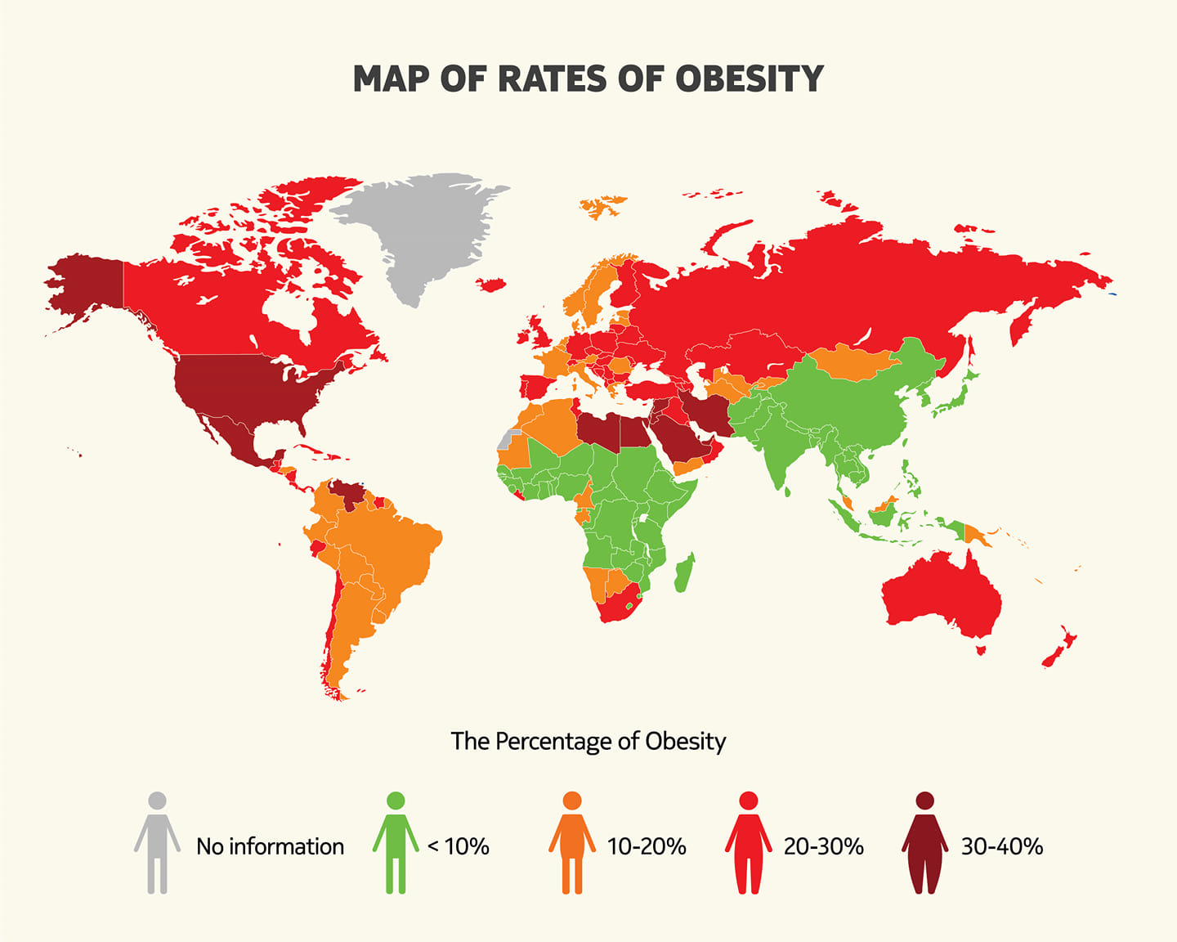
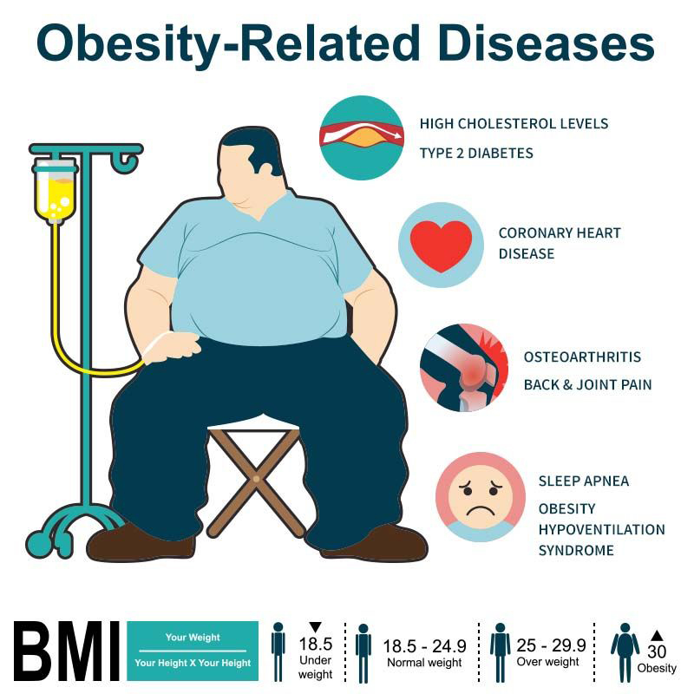
Clinical Background
In the UK, around 1 in every 4 adults and around 1 in every 5 children aged 10 to 11 are living with obesity.
Risks:
Type 2 Diabetes
Coronary Heart Disease
Some types of cancer, such as breast cancer and bowel cancer
Stroke
1
Notes:
Obesity is currently ravaging the world. Especially in the UK, the rate of obesity is high and still on the rise. Obesity can lead to many diseases, most typically including type 2 diabetes and cardiovascular disease.

Slide 3
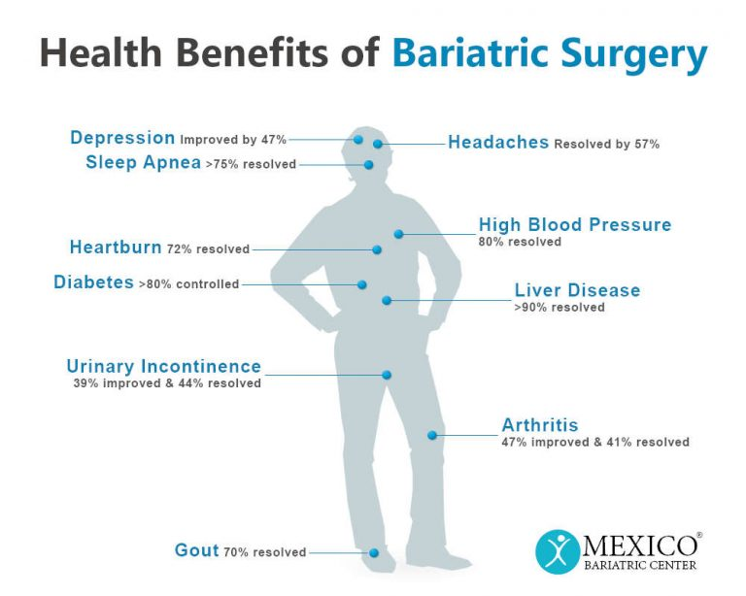
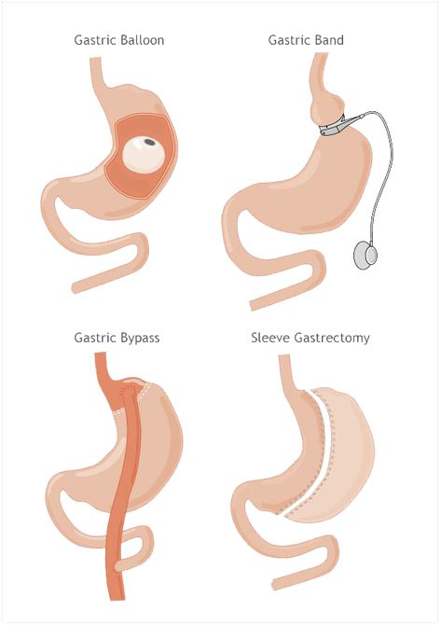
Bariatric Surgery
Body Mass Index(BMI)>40, or 35<BMI<40 with an obesity-related condition that needs bariatric surgeries.
Notes:
Many severe cases of obesity require surgical treatment, after which many health-related disadvantages can be alleviated.

Slide 4
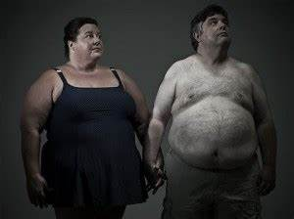
Body Image in Patients’ Mind (Without Intervention)
After Bariatric Surgery, Body Image in Patients’ Mind Does Not Change.
Negative Body Image
Internal Stigmatisation
Loss of Control Eating & Maladaptive Eating Pattern
Poor Postoperative Weight loss
Notes:
After bariatric surgery, the body imagery in the patient's mind does not change without intervention, which can lead to negative body imagery, leading to stigmatization of the patients themselves. They can’t control eating and ultimately have a poor prognosis.

Slide 5
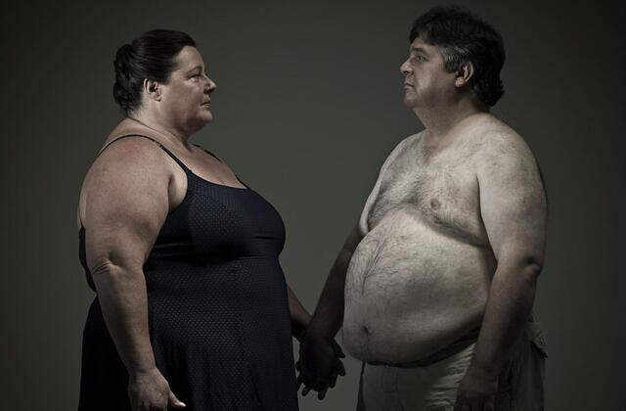
Body Image in Patients’ Mind (With Intervention)
After Bariatric Surgery, Body Image in Patients’ Mind Does Not Change.
Show Postoperative Weight Loss Portraits
Positive Body Image
Regular Eating with Confidence
Good Postoperative Weight Loss
Notes:
However, if we give the patients a reasonable intervention that shows them a normal, healthy body portrait after weight loss, this changes the body imagery in the patient's mind. As a result, their body image will be positive, and they will be able to eat normally, exercise, and have a very good prognosis.

Slide 6
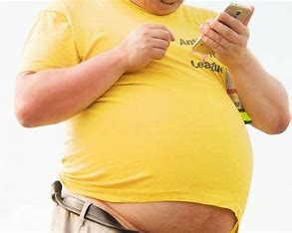
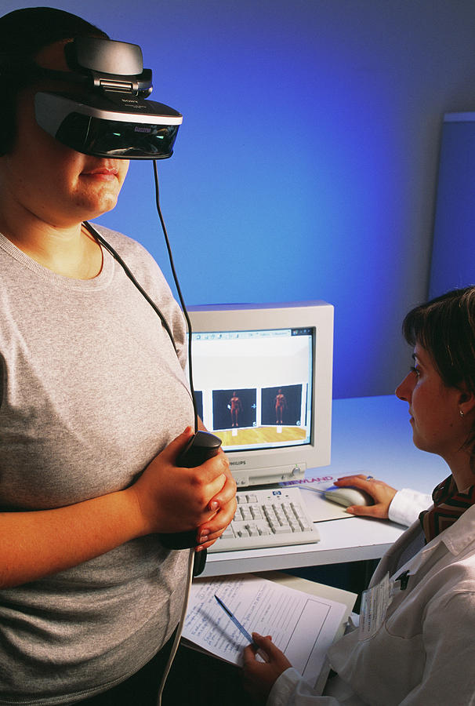
How to Showcase?
Image
VS
Virtual Reality(VR)
Lack of Immersion
Limited Perspective
Enhanced Realism
Immersive Experience
“3D reconstruction and VR is both a feasible and acceptable
method of addressing body image in bariatric surgery” （Nazrin，2022）
Notes:
There are two ways to show a body portrait after weight loss, one is a normal image and the other is virtual reality. Virtual reality is significantly more immersive and supports multiple viewing angles than just showing the patient an image of themselves, while at the same time fully perceiving the integration of themselves with their surroundings and maximizing the change in body imagery in their mind. Last year, Nazrin's research demonstrated that 3D reconstruction and virtual reality are feasible and acceptable ways to process patient images.

Slide 7
Aims & Objectives
1. Use existing technology platforms to capture in 3D the shape of participants to create patient-specific avatars.
2. Use 3D design software combined with 3D scanning avatars to simulate what patients would look like after bariatric surgery.
3. Visualise in multi-view in Unity Engine.
3D Scan
3D Reconstruction
VR Application
Notes:
Let’s move on my research. The goal of my research is to create a virtual portrait of the patient using existing technology to capture the patient's pre-bariatric morphology, and simulate and reconstruct the patient's image using state-of-the-art 3D modeling software to obtain a post-bariatric body image. Finally, VR is utilized to demonstrate the reconstruction from multiple viewpoints.

Slide 8
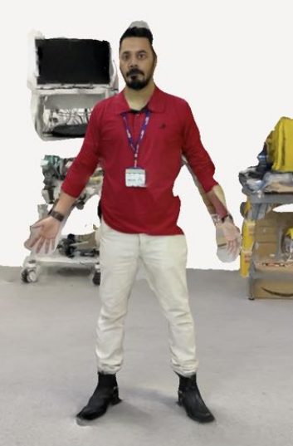
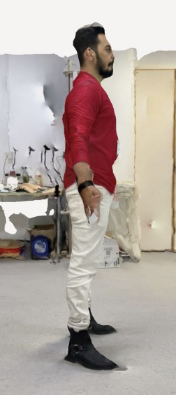
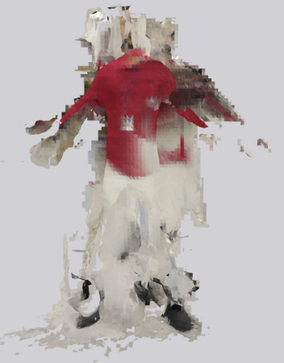
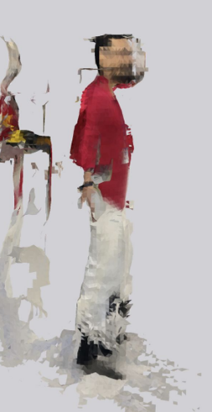
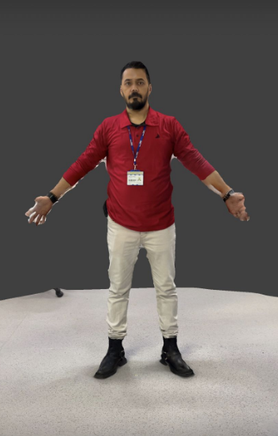
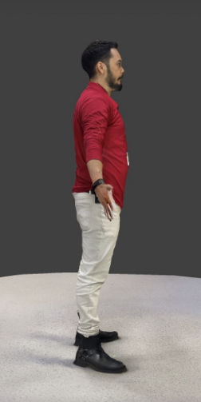
3D Scan Device & Application
3D Scanning Device: iPad Pro (3rd Generation) (Apple Inc, California, USA)
3D Scanning Application: “Polycam”, “3D Scanner APP” & “Scaniverse”(√)
Polycam
3D Scanner APP
“Scaniverse”(√)
Notes:
Firstly, for the 3D scanning part, we chose Ipad Pro3 as the scanning device, which is easy to obtain and operate. In terms of scanning applications, we chose the highly rated Polycam, 3D scanner APP and Scaniverse as alternative applications. After testing, it was clear that Scaniverse performed better, both in terms of clarity and completeness.

Slide 9
3D Scan Method
3D Scanning Device: iPad Pro (3rd Generation) (Apple Inc, California, USA)
3D Scanning Application: “Scaniverse”
3D Scanning Method: 1 min flat, 2.5 min flat & 2.5 min up & down
1.5m
1.5m
1.5m
1 min flat
2.5 min flat
2.5 min up and down
Notes:
we designed three scanning modes in terms of scanning time and scanning trajectory, which are 1 minute flat scan, 2.5 minutes flat scan and 2.5 minutes up and down scan. Flat scanning is the scanner's 1.5m distance from the subject to scan a circle in 1 minute and 2.5 minutes. Up and down scanning is the scanner is the same distance from the subject to scan a circle in 2.5 minutes, but every 90 degrees to move up and down. The purpose of scanning in this way is to be able to scan a larger area.

Slide 10
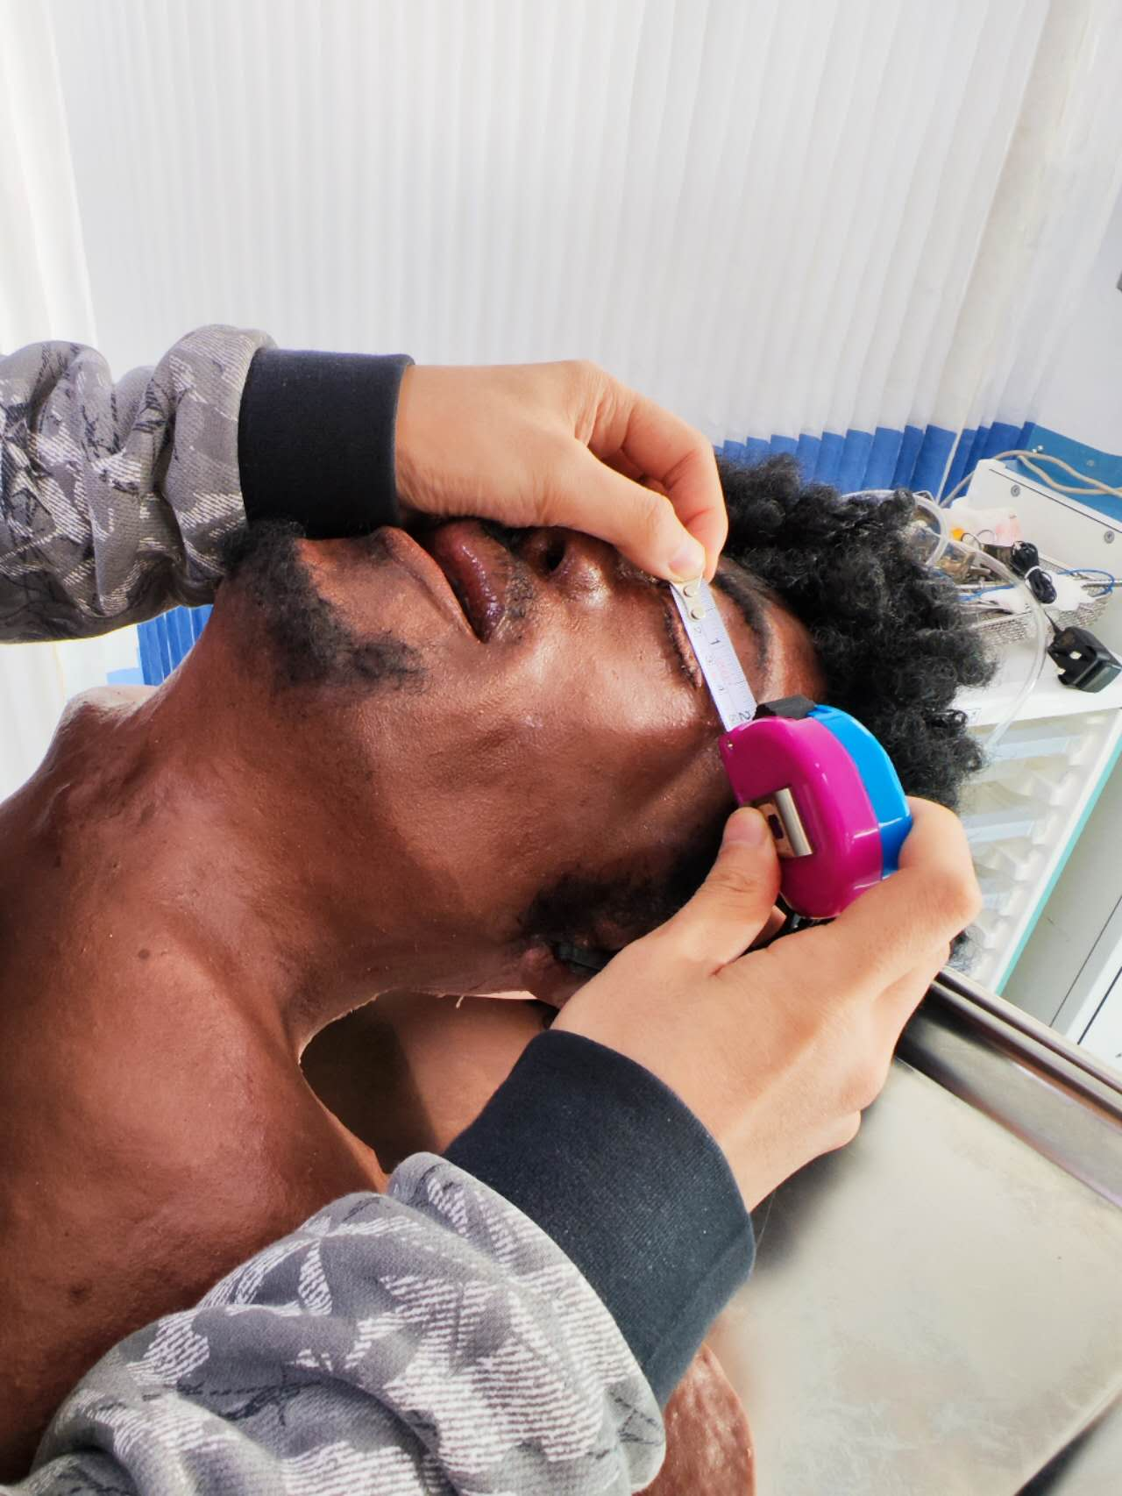
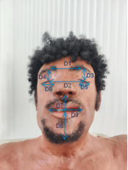
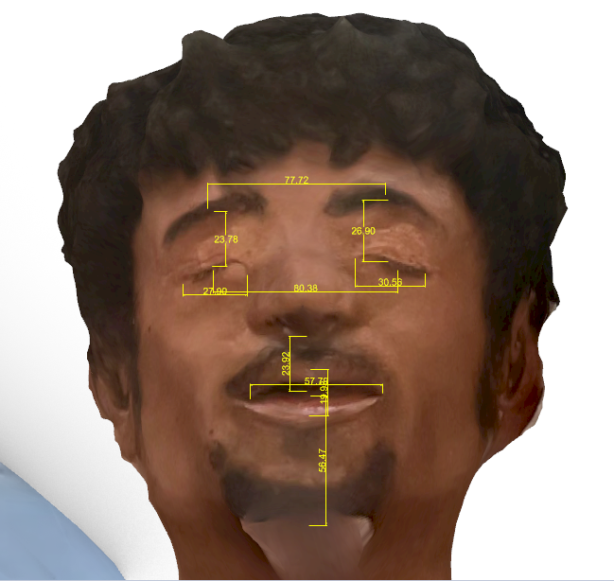
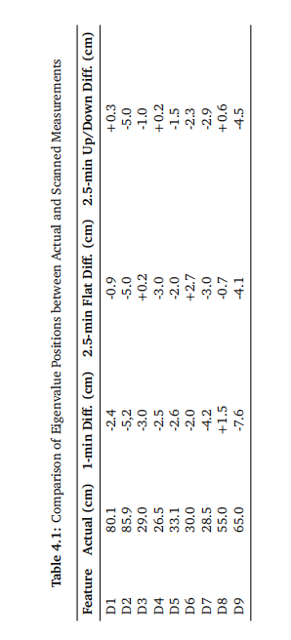
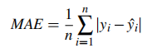
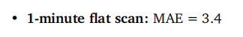
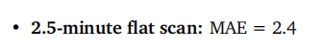
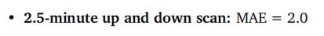
3D Scan Method: Accuracy Measurement & Comparison
Mean Absolute Error(MAE)
2.5-minute up and down scan
Notes:
We have measured the human facial features through physical measurements and virtual model of the 3D software measurements, these features are respectively eye distance, eye spacing, eyebrow spacing, etc. Mean Absolute Error is a widely used reference value for measurement accuracy, by comparing this value, I calculated the minimum MAE for the 2.5min up and down scanning, and finally decided to use this method as the official scanning method.

Slide 11
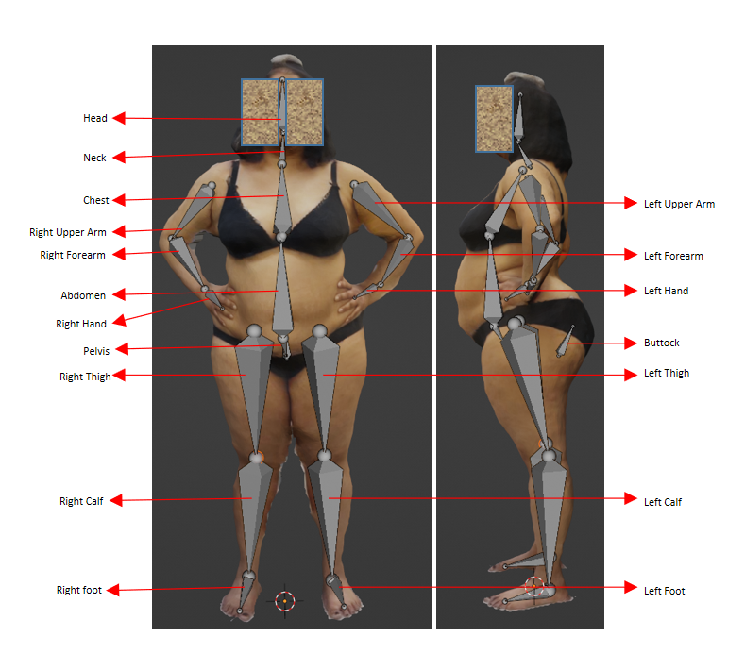
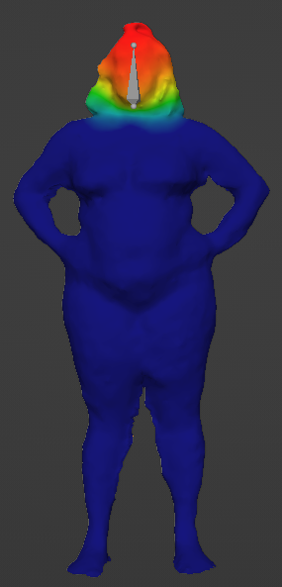
3D Reconstruction: Armature Design and Binding
Notes:
Then, when it comes to the 3D reconstruction, I designed a set of armature for this purpose. Each bone controls the corresponding body part, and the overall body size can be reduced through localized reduction of the body.

Slide 12
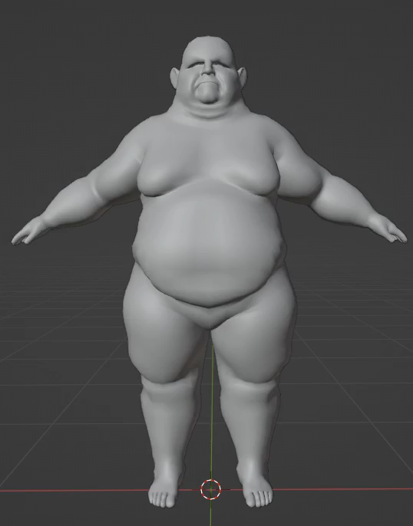
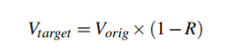
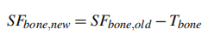
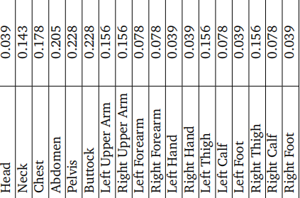
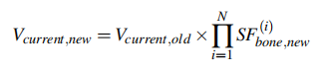
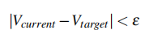
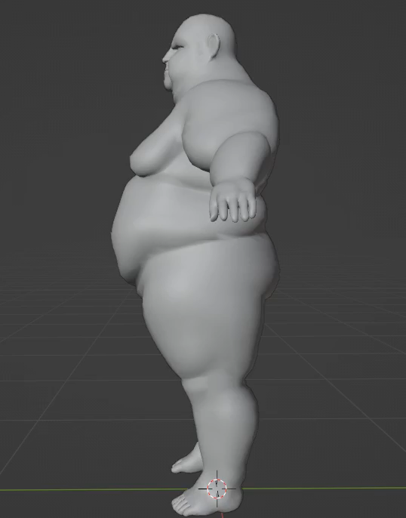
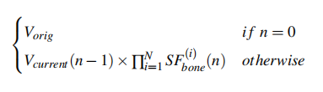
Armature Resizing Algorithm
Input
Body Part
Tolerance
“Anthropometrics by three-dimensional photonic scanner in patients with obesity before and after bariatric surgery,” (A. Shah et al. 2021)
Notes:
To do this, I designed a unique algorithm that adjusts the percentage of weight loss for each part. I need to first input how much volume to lose, and the algorithm iteratively reduces the volume from the original by assigning a proportionality factor to each part. This factor is determined by an existing postoperative anthropometric study of bariatric surgery. The algorithm stops when the reduction reaches an interval that is very close to the targeted volume.

Slide 13
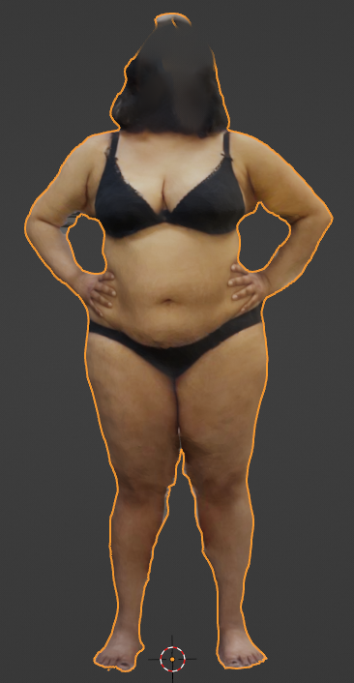
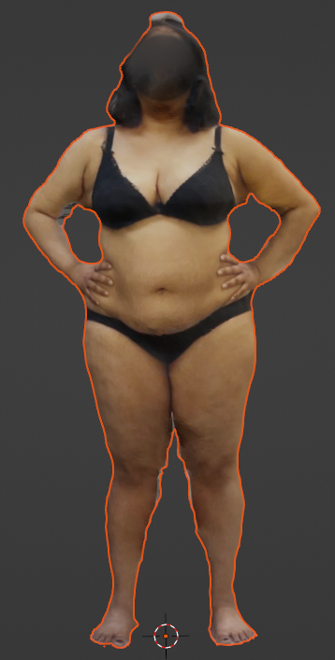
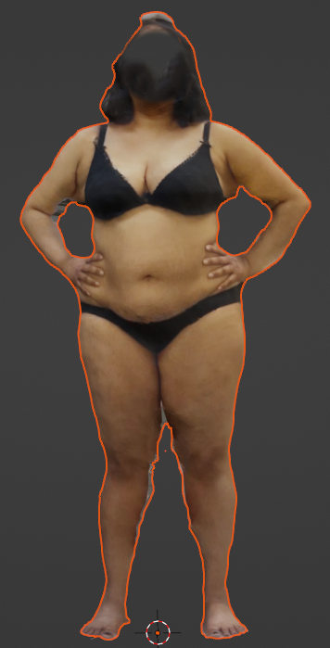
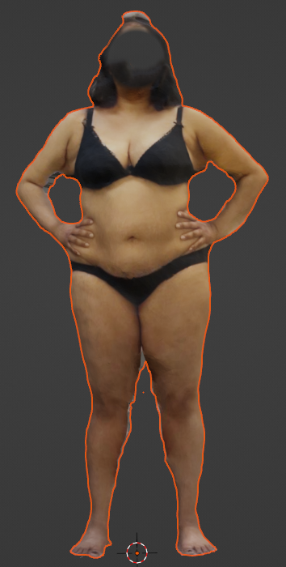
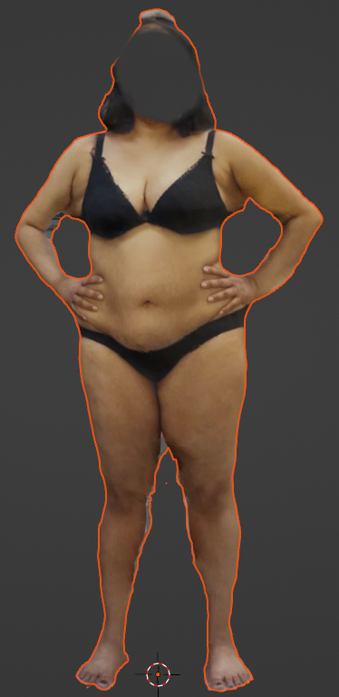
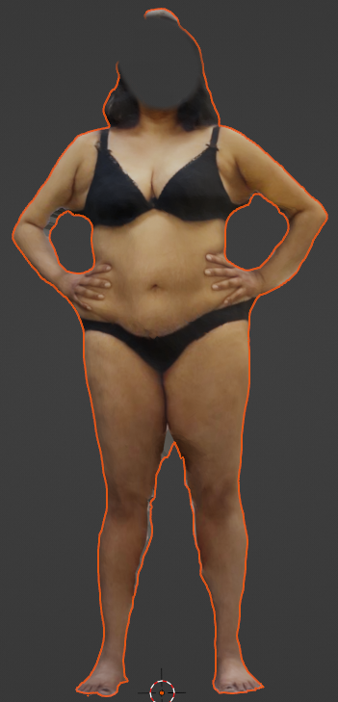
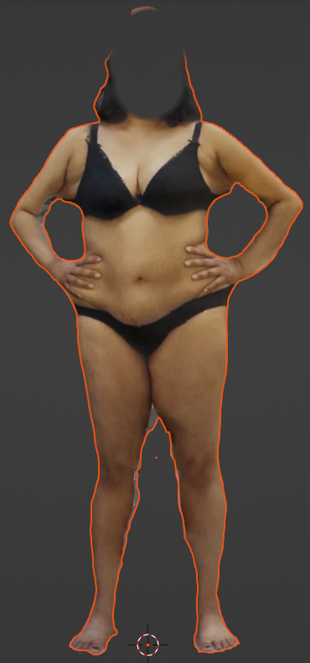
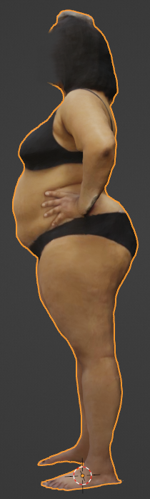
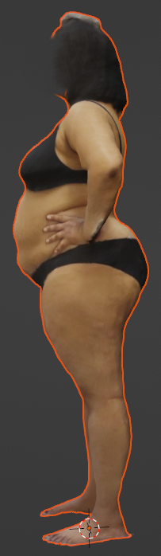

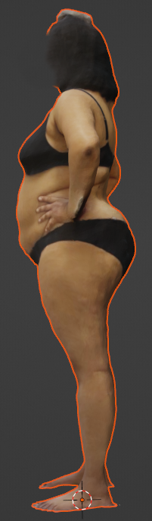
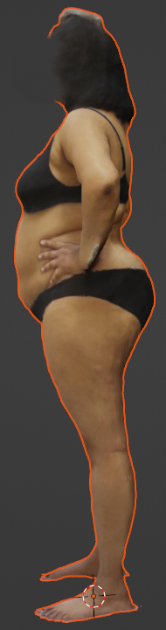
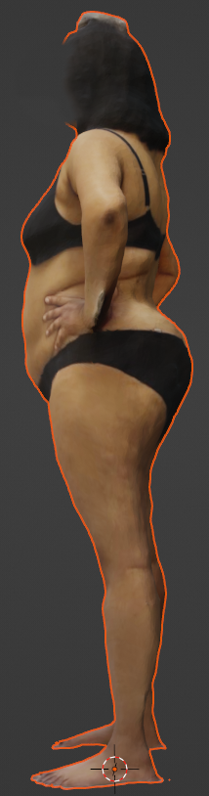
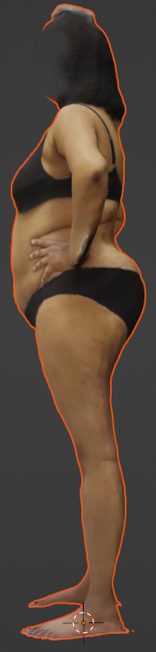
Body Weight Reduction(Without Skin Folds)
Original
5% WL
10% WL
15% WL
20% WL
25% WL
30% WL

Slide 14
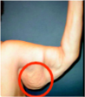
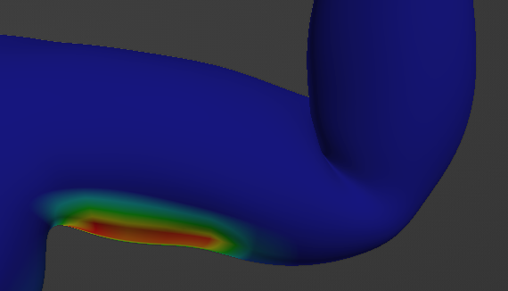
Skin Folds

Slide 15
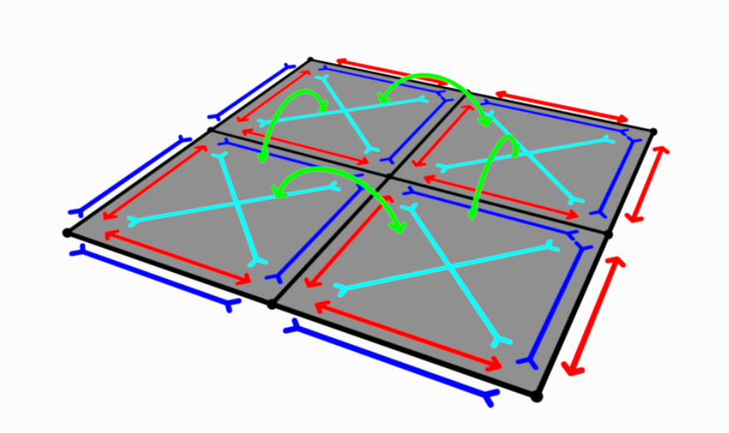
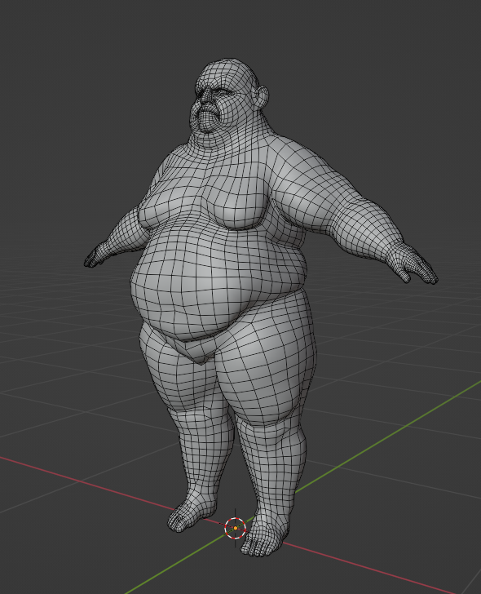
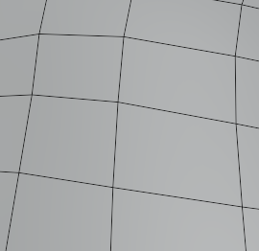




Skin Folds Simulation: Mass-Spring Model
Illustration of Mess-Spring Model ; tension springs (blue), compression springs (red), shear springs (cyan), and angular bending springs (green).

Slide 16






Skin Folds Simulation Grading(Arm)
illustration *
Original
Grade 1
Grade 2
Grade 3
Grade 4
* “An anthropometric classification of body contour deformities after massive weight loss”(M. Iglesias et al. 2010)

Slide 17





Skin Folds Simulation Grading(Thighs)
illustration *
Original
Grade 1
Grade 2
Grade 3
* “An anthropometric classification of body contour deformities after massive weight loss”(M. Iglesias et al. 2010)

Slide 18






Skin Folds Simulation Grading(Abdomen)
illustration *
Original
Grade 1
Grade 2
Grade 3
Grade 4
* “An anthropometric classification of body contour deformities after massive weight loss”(M. Iglesias et al. 2010)

Slide 19









Skin Folds Simulation Grading(Mammary Gland for Female)
illustration *
Original
Grade 1
Grade 2
Grade 3
* “An anthropometric classification of body contour deformities after massive weight loss”(M. Iglesias et al. 2010)

Slide 20




3D Reconstruction Results Showcase (Participant 1)
Original
25% WL
Original
25% WL

Slide 21




3D Reconstruction Results Showcase (Participant 2)
Original
25% WL
Original
25% WL

Slide 22




3D Reconstruction Results Showcase (Participant 3)
Original
25% WL
Original
25% WL

Slide 23




3D Reconstruction Results Showcase (Participant 4)
Original
25% WL
Original
25% WL

Slide 24




3D Reconstruction Results Showcase (Participant 5)
Original
25% WL
Original
25% WL

Slide 25




3D Reconstruction Results Showcase (Participant 6)
Original
25% WL
Original
25% WL

Slide 26



VR Applications
Cloak Room
Beach
Swimming Pool

Slide 27



VR Applications: 3rd Perspective View

Slide 28



VR Applications: 1st Perspective View

Slide 29
Key Achievements
Improving scanning accuracy
Accurate weight loss by body part
Graded simulation of skin fold effects
Processing and automating 3D reconstruction
Designing multiple VR perspectives

Slide 30
Limitations
1. Device limitations result in poor scanning texture accuracy
2. Requires manual adjustments and labeling leading to incomplete automation of the process
3. Lack of tracking and validation experiments to verify simulation performance
Future Work & Opportunities
Test simulation efficacy using expert ratings or postoperative follow-up, etc.
Recruiting more participants to validate simulation algorithms.
Skin fold simulation has some room for improvement.
With updated machine learning algorithms, there will be opportunities for fully automated simulations in the future.

Slide 31
Acknowledgements
Professor Fernando Bello
Nazrin Assaf
Dr Reza Haghighi Osgouei
Agni Lahiri
Runmeng Ding
Shun Yao
Haoyu Wang
Q & A

Slide 32
Thank you!

